Slide 1
EXPLORATORY DATA ANALYSIS ON LIFE EXPECTANCY DATASET
Group MEMBERS
BENEDICT ATTA BINEY
ALEXANDER KISSIEDU EVANS ANKOMAH

Slide 2
OUTLINE
Introduction
Hypothesis
Hypothetical question
Conclusions

Slide 3
INTRODUCTION
EDA based on a dataset from Global Health Observatory (GHO) data repository under World Health Organization (WHO) for the period of 2000-2015 for all countries

Slide 4
HYPOTHESIS
Life expectancy in developed countries seem to be better than that of developing countries.

Slide 5
HYPOTHETICAL QUESTIONS
What is the distribution of countries by their status?
What is the life expectancy trend of over the years?
What is the average life expectancy in developing and developed countries each year?
How do the various immunizations (Hepatitis B, Polio and Diphtheria) relate to life expectancy?
Which countries have high life expectancy despite having low schooling?

Slide 6
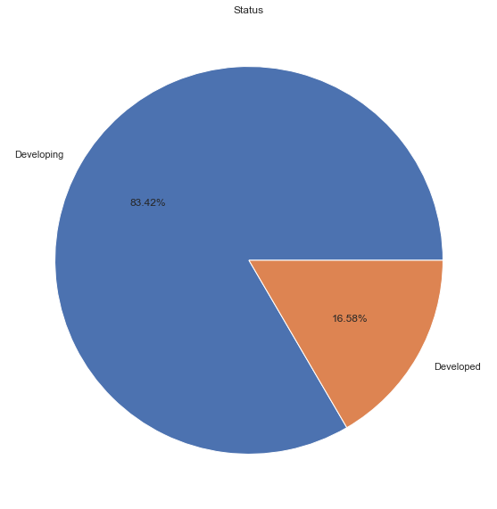
QUESTION 1:What Is the distribution of countries by their status?
we can clearly see that out of the 183 countries
Only 16.58% of the countries are classified as developed.
and 83.42% of the countries are classified as developing

Slide 7
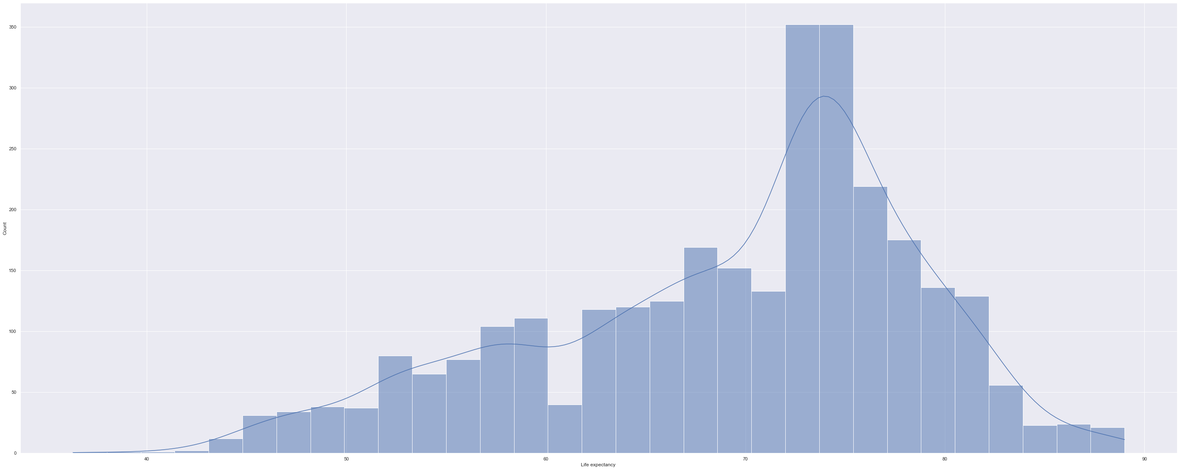
QUESTION 2: What is the life expectancy trend of over the years?
It appears that most countries over the years have their life expectancy between 65 and 80

Slide 8
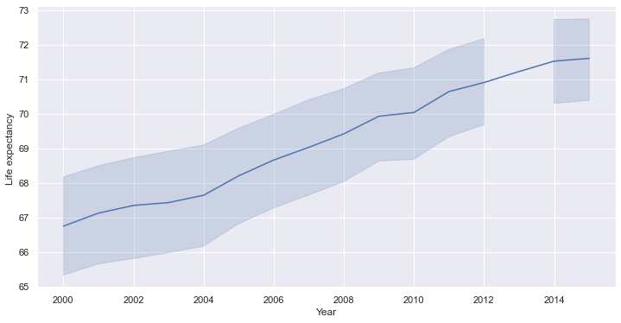
QUESTION 2: CONTD.
It also appears that life expectancy has been improving over the years. However, there was a low growth between 2009 and 2010

Slide 9
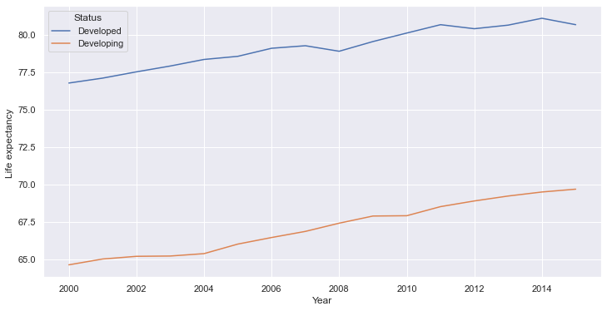
QUESTION 3: What is the average life expectancy in developing and developed countries each year?
we can clearly see that there was has be improvement in both developed and developing countries over the years(2000-2015)
however, there was a
decline in 2008 and 2012 for developed countries
decline between 2009 and 2010 for developing countries
a slow growth between 2002 and 2004

Slide 10
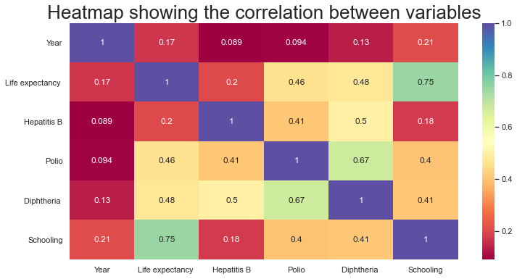
QUESTION 4: Which countries have high life expectancy despite having low schooling?
There is a weak positive correlation between Life expectancy and Hepatitis B (r=0.2)
There is a moderate positive correlation between Life expectancy and Polio (r=0.46)
There is a moderate positive correlation between Life expectancy and Diphtheria (r=0.48)
There is a strong positive correlation between Life expectancy and Schooling (r=0.75)

Slide 11
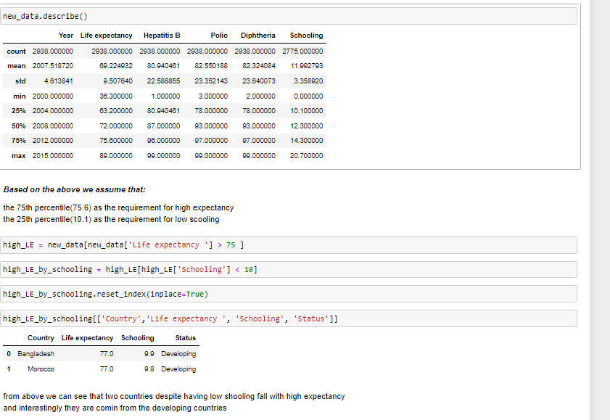
QUESTION 5: Which countries have high life expectancy despite having low schooling?
Two countries despite having low schooling fall within high expectancy
And interestingly they are all coming from coming the developing countries

Slide 12
CONCLUSION
We can strongly say that schooling and immunization interventions (Polio, Hepatitis B, and Diphtheria) are somehow linked to life expectancy, that’s an increase in schooling and immunization intervention (Polio, Hepatitis B, and Diphtheria) will improve life expectancy.
To conclude Life expectancy is better in developed countries than developing ones which confirms our initial hypothesis.

Slide 13

THANK YOU

